Slide 1
Cleaning data in SQL
CBN exchange rate dataset
Richard Ogoma/ July 15, 2022

Slide 2
Problem:
Solution:
Dirty exchange rate dataset unusable for descriptive and predictive analysis
Help the analytics team transform and clean the exchange rate dataset to make it more usable for analysis

Slide 3
Data processing goals
WHY: How dirty is the data?
HOW: Demonstrate the data transformation from dirty to clean

Slide 4
Data processing goals
WHY: How dirty is the data?
HOW: Demonstrate the data transformation from dirty to clean

Slide 5

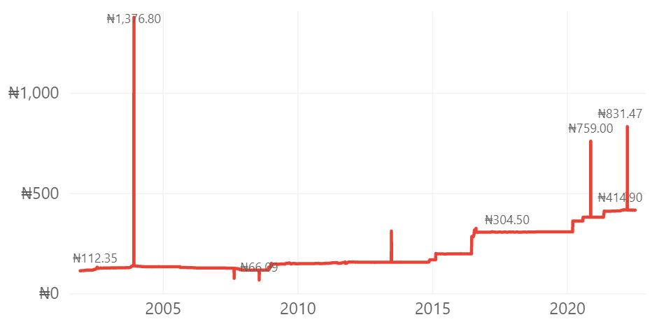
Unprocessed NGN/USD Central Exchange Rates Since 2001
Extremely high data points
Abnormally low data points
Source: CBN Exchange Rate Data as of 15th July 2022
Notes:
Key take away: segment!! A lot of people think that LTV is an acquisition play, but it also a retention play.
Marketing! What can you actually do when you know the LTV of customers? Here’s an example:
Let’s say you looked at your customer base, the value it drives for your business, you measured CLV of all your users, and you identified a few (4) ‘types’ of people: buckets or segments. It could look something like this + you could adjust how you treat these users through marketing efforts or inside the game (game play / monetization).

Slide 6
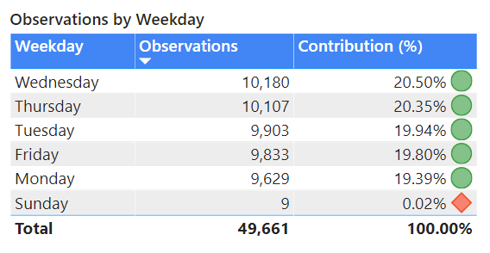
Business Day Data
Exchange rates were typically recorded on Monday through Friday; with only 9 records on Sunday and no record on Saturday.
Source: CBN Exchange Rate Data as of 15th July 2022

Slide 7
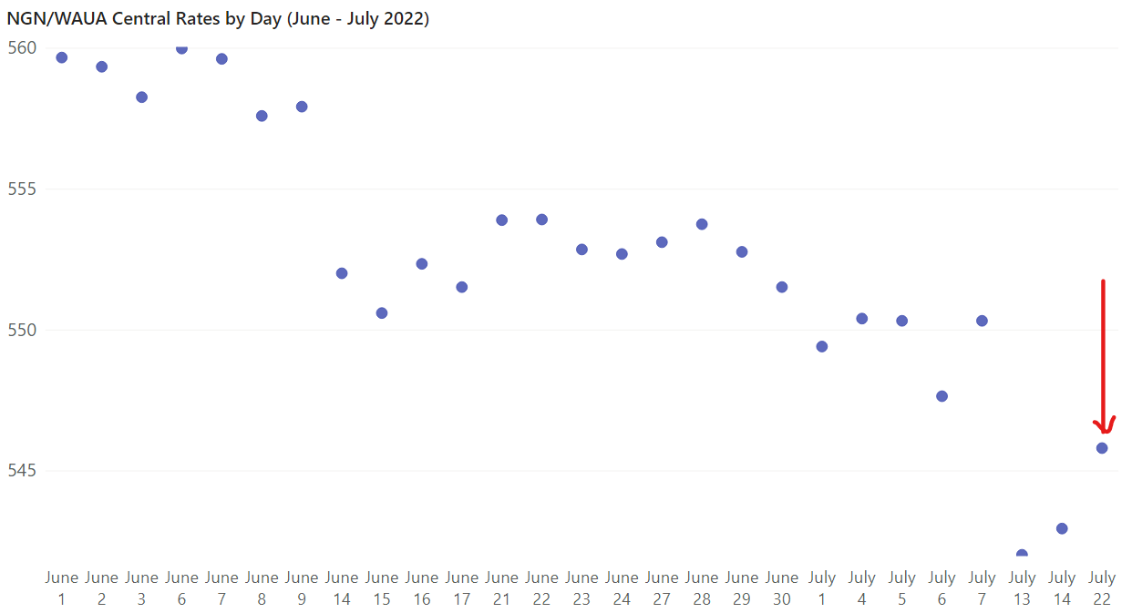
Futuristic Dates
Exchange rate data was erroneously recorded beyond the current date.
Source: CBN Exchange Rate Data as of 15th July 2022

Slide 8
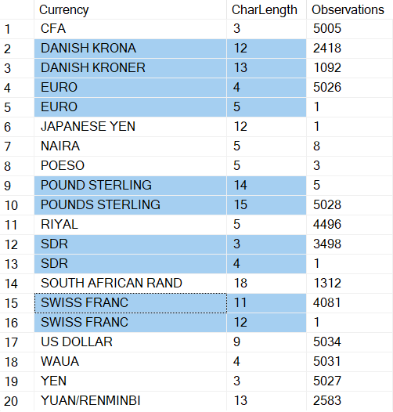
Trailing/Leading Spaces
There were trailing or leading spaces in the currency names, and some were misspelt.
Source: CBN Exchange Rate Data as of 15th July 2022

Slide 9
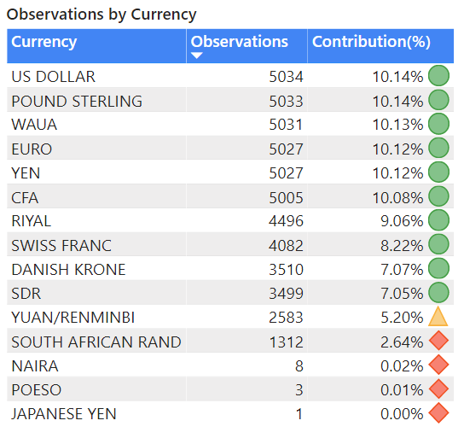
Insufficient Data
The NAIRA*, the POESO, and the JAPANESE YEN contributed just 0.03% to the total observations since 2001.
Source: CBN Exchange Rate Data as of 15th July 2022
* The NAIRA shouldn’t be in the dataset, because the rates represent the value of foreign currencies in terms of the NAIRA.

Slide 10
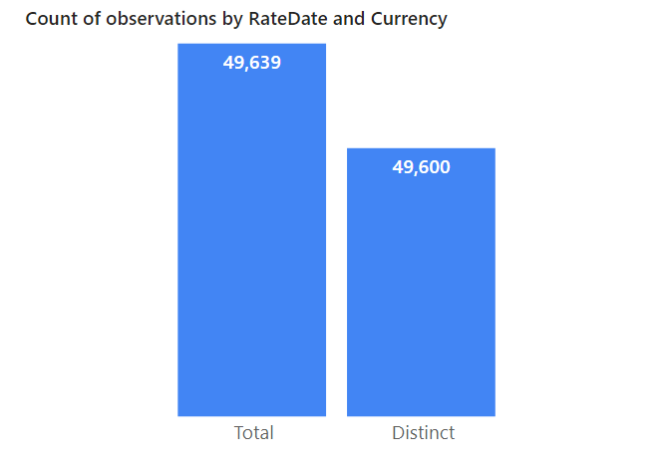
39 duplicates
Duplicates
There ought to be a singular currency observation for each day, however, there are 39 duplicate observations.
Source: CBN Exchange Rate Data as of 15th July 2022

Slide 11
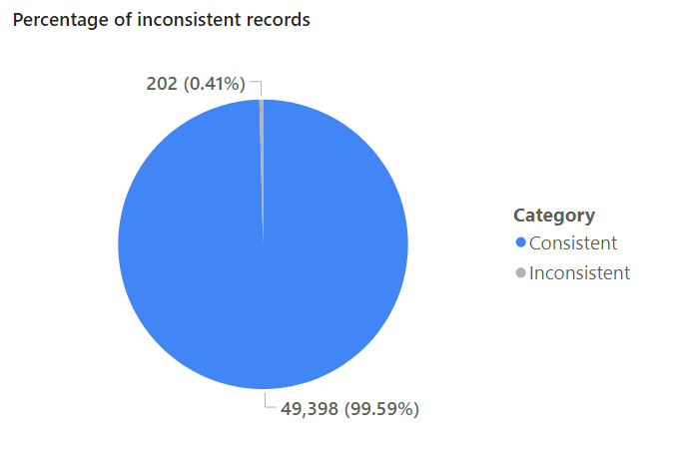
Inconsistent Records
The RateYear and RateMonth fields ought to be consistent with the derived Year and Month features from the RateDate, but there are 202 inaccurate records.
Source: CBN Exchange Rate Data as of 15th July 2022

Slide 12
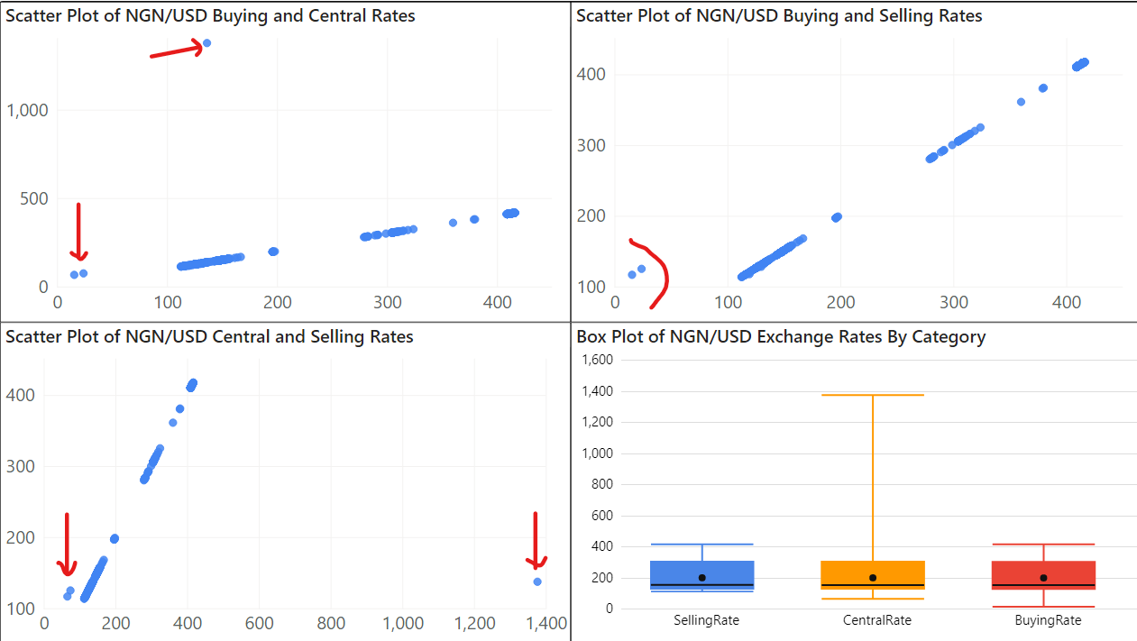
Outliers
There are datapoints that differ substantially from the rest of the data. The maximum rate is 1376.80NGN/USD, and the least is 15.59NGN/USD in contrast to a typical average rate of 201.35NGN/USD.
Source: CBN Exchange Rate Data as of 15th July 2022

Slide 13
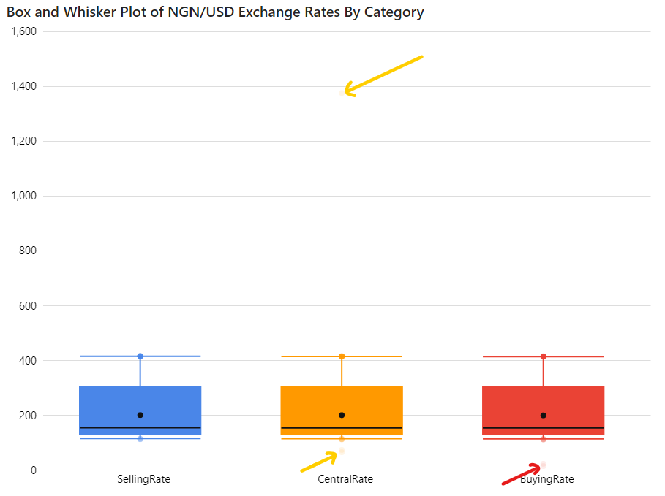
Outliers
Our data is distributed between 115.10NGN/USD and 416.09NGN/USD for each rate category. However, there are abnormal datapoints that fall outside this range.
Source: CBN Exchange Rate Data as of 15th July 2022

Slide 14
Data processing goals
WHY: How dirty is the data?
HOW: Demonstrate the data transformation from dirty to clean

Slide 15
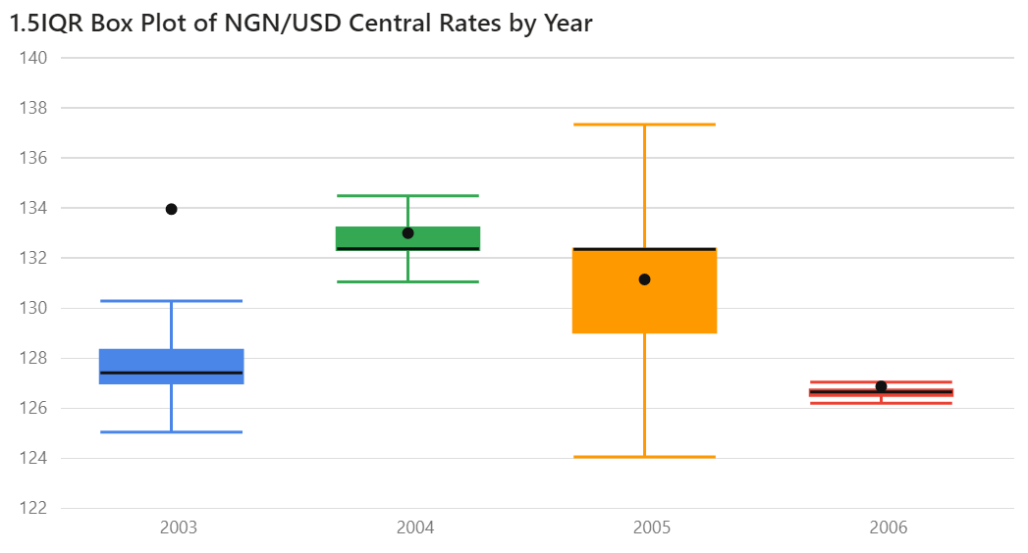
The Interquartile Range
One statistical method of identifying outliers is by the interquartile range, or IQR. When we find rates that fall outside of 1.5 times the range
between our first and third quartiles, we typically consider these to be outliers.
Source: CBN Exchange Rate Data as of 15th July 2022

Slide 16
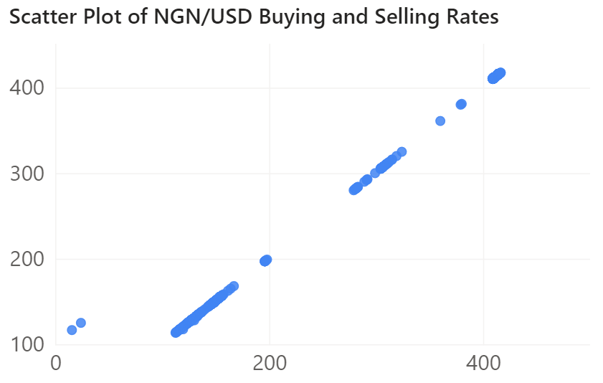
The Absolute Deviation
There is a strong positive correlation and “typically” no difference between the rates. So, rates having at least one-point absolute distance from the lateral mean and exceed 1.5 times the IQR, are considered anomalous datapoints.
Correlation coefficient, r = 0.999772
Source: CBN Exchange Rate Data as of 15th July 2022

Slide 17
How was the data cleaned?
This describes the methodology used in processing the exchange rate data
Rates that fall outside 1.5 times the IQR, having at least 1-point absolute deviation from the lateral mean were identified as anomalous data points
Anomalous exchange rates were replaced with the longitudinal average of the preceding and following rates of the observed datapoints
Due to the business day constraint, the rates were transformed to monthly averages to avoid the interpretation of a non-existent daily trend
Other issues identified with the data, for example, duplicates and futuristic dates, were either updated with the correct values or deleted to avoid skewing the data

Slide 18
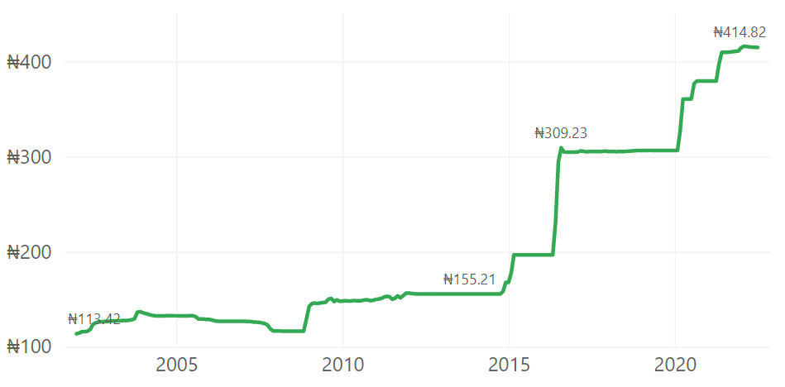
Processed Average Monthly NGN/USD Central Exchange Rates Since 2002
In 2016, the central bank banned the sale of dollars to exchange bureaux to avoid depleting Nigeria’s reserves after a sharp drop in oil prices.
Source: CBN Exchange Rate Data as of 15th July 2022
Notes:
Key take away:
The value of the US Dollar has strengthened against the NGN by over 266% since 2002.
In 2016, the value of the US Dollar rose sharply by the widest margin by over 55% from the previous year (end-of-year rates).
There is a correlation between this sharp decline and the action of the CBN in that year.
In 2016, the central bank banned the sale of dollars to exchange bureaux to avoid depleting Nigeria’s reserves after a sharp drop in oil prices. The move triggered a 60% fall in the currency on the parallel market and a sharp devaluation on the spot market.
-- Source: https://www.reuters.com/article/us-nigeria-currency-idUSKBN2EY25W

Slide 19
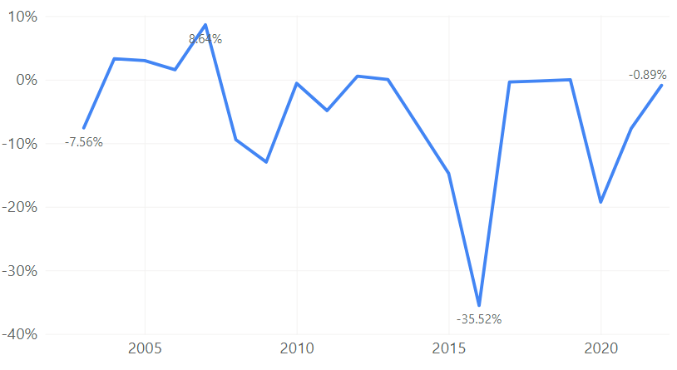
How has the Nigerian NGN depreciated since 2002?
The Nigerian Naira appreciated against the dollar through 2007 due to high oil revenues.
Sharp drop in oil prices in 2016, triggered a 36% fall in the official Naira market rate.
Source: CBN Exchange Rate Data as of 15th July 2022
Notes:
Key take away:
The value of the Naira has depreciated against the US Dollar by 70% since 2002 and has been on a consistent year on year decline since 2007.
In 2016, the Naira suffered the steepest devaluation, falling by over 35% from the previous year (end-of-year rates).
In 2007, the Naira strengthened against the US Dollar by over 9% from the previous year
There is also a correlation between this steep appreciation and the action of the CBN in that year.
The Nigerian Naira appreciated against the dollar through 2007 due to high oil revenues. The government also planned to redenominate its currency from August 2008, so that 100 old naira will become 1 naira. This sentiment influenced the market and contributed to the sharp appreciation in the Naira and the end-of-year central rate fell from 126.52NGN/USD to 116.45NGN/USD.
-- Source: http://news.bbc.co.uk/2/hi/business/6946604.stm
------------------------------------
Conclusively,
There is a strong positive correlation between our oil revenue and the value of the Naira, as higher oil revenues led to an appreciation in the value of the currency in 2007, and a sharp drop in oil prices in 2016 led to a depreciation in its value.
There is also a strong influence of the CBN over the exchange rate, and policies can influence its value. It is also true that the Central Bank sets the exchange rate. Reference: https://en.wikipedia.org/wiki/Nigerian_naira#cite_note-27
-------------------------------------------------------
Nigeria’s daily crude oil production has fallen further to 1.024 million barrels per day (mbpd) in the month of May 2022, a 15.9% decline compared to 1.219mbpd recorded in the preceding month. Crude oil revenue is a major component of Nigeria’s revenue, accounting for over 50% of the nation’s revenue. However, due to a persistent decrease in production and export, Nigeria’s oil revenue has continued to underperform despite rising crude oil prices.
-- Source: https://nairametrics.com/2022/06/15/nigerias-oil-revenue-at-risk-as-production-falls-further-to-1-02-million-barrels-per-day/

Slide 20
Thank You

